Slide 1
Game Algorithms
GAM 1574
Dan Lingman
lingmad@algonquincollege.com
https://www.facebook.com/Dan.Lingman
https://www.linkedin.com/pub/dan-lingman/1/51a/300
https://twitter.com/Lingman
dlingman@gmail.com

Slide 2
Splines
Bezier curves vs. Catmull-Rom
Applications of splines
Gizmo's in Unity to aid in debugging
Hands on:
Implement Catmull-Rom spline code
Visualize the paths and their normal using gizmos and Debug.draw*

Slide 3
Splines
So what is a spline? A spline is a mathematically generated curve, defined by a number of control points. In pure mathematics, these are a number of connected polynomial sections.
In computer graphics (and games), we tend to use parameterized functions.
You've all seen one before. A circle.
x =cos(angle), y = sin(angle)

Slide 4
Bezier Curve
There are many forms of Bezier curves. They all depend on a number of control points, and linear interpolation between pairs of control points.
Typically a time value, t is allowed to range between 0 and 1, with 0 representing one end of the curve, and 1 representing the other end.

Slide 5
Linear Bezier Curve
With two control points, what you get is a straight line between points A and B, with the linearly interpolated (Lerp) value being defined as:
Lerp(t,a,b) = (1-t)a + tb
At t = 0, then the point along the line is at a.
At t = 1, then the point along the line is at b.

Slide 6
Quadratic Bezier Curve
With three control points, what you get is a parabolic type shape between the first and last points, adjusted by where the third point is.
We can recursively compute the location at a given t along this curve. If we are given P0,P1,P2 as the control points, and t is the parameter between 0 and 1, then the following steps give the location along the curve.

Slide 7
Quadratic Bezier Curve
Q0 = Lerp(t,P0,P1)
Q1 = Lerp(t,P1,P2)
result = Lerp(t,Q0,Q1)

Slide 8
Cubic Bezier Curve
A cubic Bezier Curve has 4 control points P0,P1,P2, and P3. Again, we interpolate between pairs of them to get intermediate points, then a third time to get secondary intermediate points, and a fourth time to get the actual point on the curve.
Q0 = Lerp(t,P0,P1), Q1 = Lerp(t,P1,P2),
Q2 = Lerp(P2,P3)
R0 = Lerp(t,Q0,Q1), R1 = Lerp(t,Q2,Q2)
Result = Lerp(t,R0,R1)

Slide 9
Cubic Bezier Curve
Confused yet? Follow this link to get to play with the t value (and the location of the control points)
https://richardfuhr.neocities.org/BusyBCurves.html

Slide 10
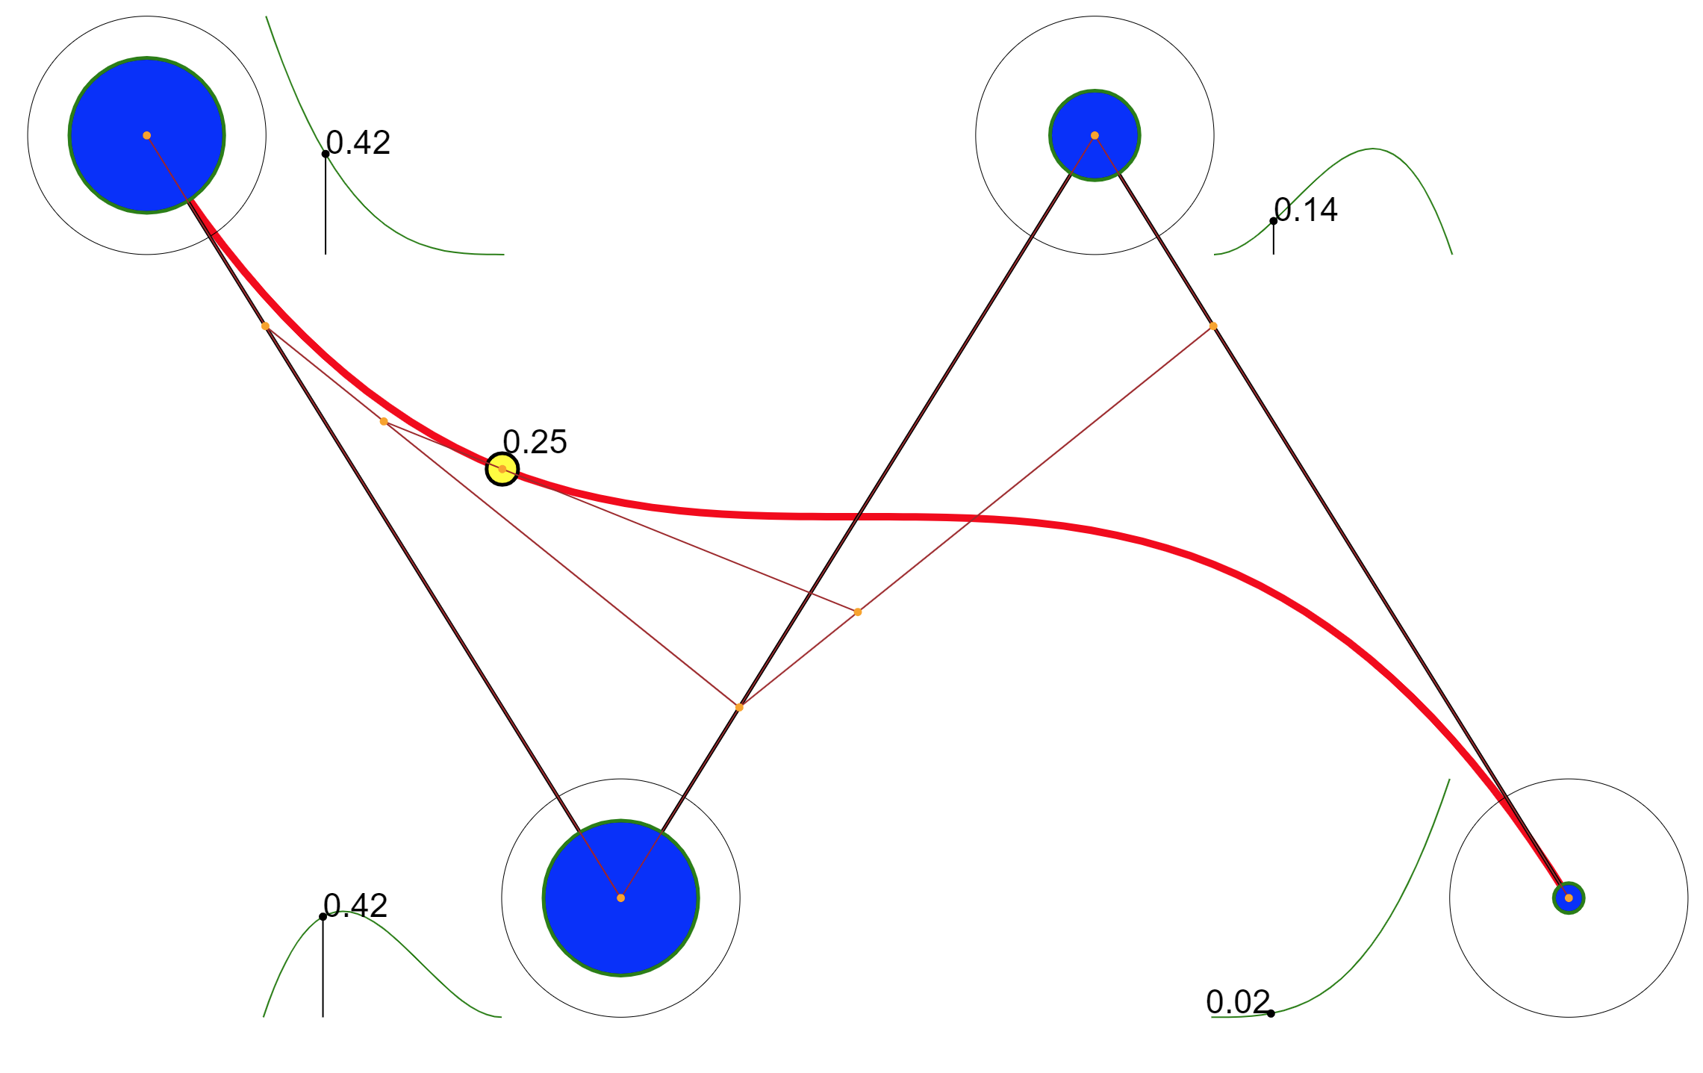
Cubic Bezier Curve
Here, t is at 0.25, and we can see the three layers of interpolation taking place.
Q0
Q2
R0
R1
Q1

Slide 11
Connecting Bezier Curves into a longer path
This is actually a bit messier. Failing to connect adjacent Bezier Curves correctly will give you sharp corners at the control points where the pairs of curves meet.
There are ways to mitigate this, at the loss of some ability to control exactly where all the control points are located. This is not really a good solution for us in all cases.

Slide 12
Shortcoming of Bezier Curves
Only passing through some of the control points is the biggest issue with Bezier Curves.
If you're defining a roadway, you'll have laid down the points you want that road to pass through.
Enter Catmull-Rom splines.
Specifically, Centripetal Catmull-Rom splines.

Slide 13
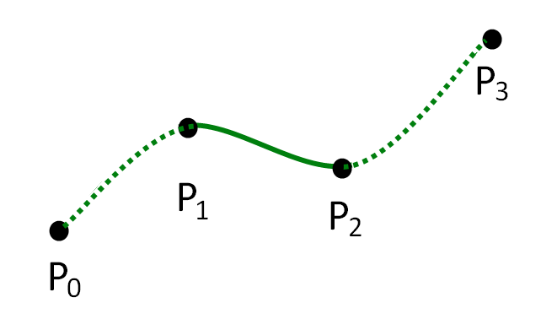
Centripetal Catmull-Rom Splines
Like cubic Bezier curves, these also use 4 control points, with the path passing through two of them. Why are we bothering? The image below (from Wikipedia) shows the big difference - which two control points we go through.
Image By Hadunsford - Own work, CC BY-SA 3.0, https://commons.wikimedia.org/w/index.php?curid=28956755

Slide 14
Centripetal Catmull-Rom Splines
We're traversing the middle two points instead of the two outer points. This suggests that if we construct things properly, we can shift our control points around, and if we pick the right slopes for things passing through the control points, we get a nice curve.
Note that if you do this, it still won't pass between the first and last point unless you cheat. Or, if you have a closed loop…

Slide 15
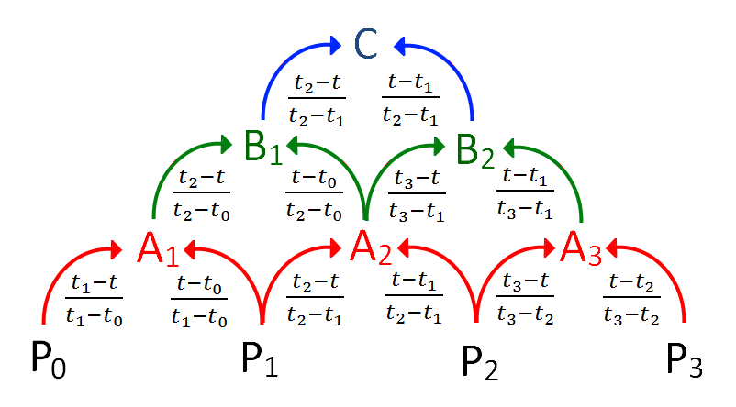
Centripetal Catmull-Rom Splines
It's made of math.
By Hadunsford - Own work, CC BY-SA 3.0, https://commons.wikimedia.org/w/index.php?curid=28956843

Slide 16
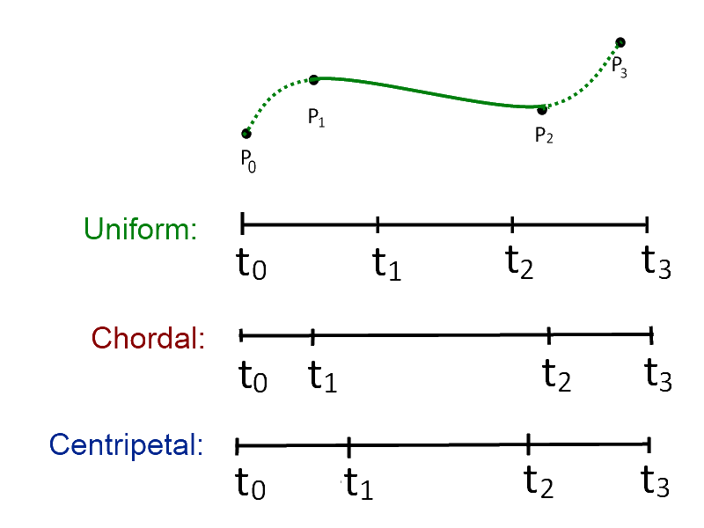
Centripetal Catmull-Rom Splines
So what does all that mean?
P0-P3 are the 4 control points.
C is the resulting position on the spline, between points P1 and P2, given a t value between t1 and t2.

Slide 17
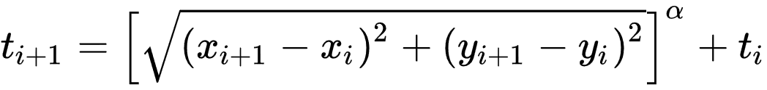
Centripetal Catmull-Rom Splines
And what are t0, t1, t2, t3? t0 is 0. The rest can be computed from the coordinates of the control points.

Slide 18
Centripetal Catmull-Rom Splines
The A's and B's are calculated by multiplying the control points by the numbers shown in the cascade, and adding the results together. repeat enough times, and you wind up with the final spline location, C.
The Wikipedia page on Centripetal Catmull-Rom splines has Unity source code. I've modified the onGizmo code a bit to show the tangents of the control points as the curve passes through.

Slide 19
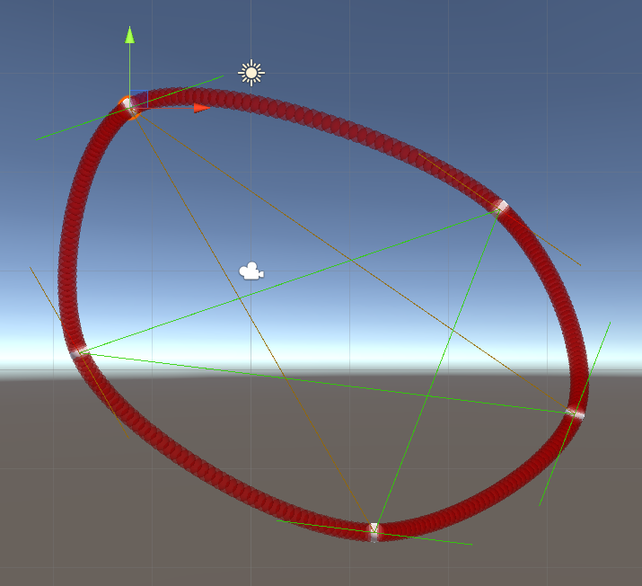
Centripetal Catmull-Rom Splines
Note that the tangent to the curve at a control point is the same slope as the line connecting the control points on either side of it. (I have 5 copies of the code running here, each giving one segment of our connected spline.)

Slide 20
Centripetal Catmull-Rom Splines
The source code for this is in this week's folder. Download it, open up Unity, and drag it into the asset folder.
Construct an empty game object, and 4 control points (I used spheres that I scaled down).
Add the Catmull script to the empty game object, set the size of the point array to 4, and drag in the control points.

Slide 21
Centripetal Catmull-Rom Splines
Turn on Gizmos, and you'll see the tangent lines show up. hit play, and the connecting spheres showing the path from the middle two control points will show up.

Slide 22
Centripetal Catmull-Rom Splines
Hands on:
Get that much running, then expand it out to show multiple connected paths. You might need more waypoints, and you'll need one more manager game object for each path segment.
This will work and look fine, but doesn't give you a continuous set of points for the entire connected spline. That's your next task.

Slide 23
Centripetal Catmull-Rom Splines
Hands on:
Convert your code as follows:
Create a function that, given a set of 4 waypoints and a number of intermediate points (an int), will return an array of those points.
Call this function repeatedly, accumulating the points into one master array. watch out for the end condition, as you'll need to wrap around.

Slide 24
Centripetal Catmull-Rom Splines
Hands on:
Finally, display the entire path, along with tangent lines. Add in short normal for each point. (use the coordinates of the points on either side as a vector that you need to find a perpendicular of.)

